Slide 1
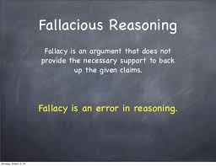
Critical Thinking Part 3 – Fallacious Reasoning
Sourced from:
Lumsden. D, Lumsden. G & Wiethoff. C. 2010. Communicating in groups and teams: Sharing Leadership, Part III: Sharing leadership through task processes: Logical and Critical Thinking, 5th ed. Cengage Learning.

Slide 2
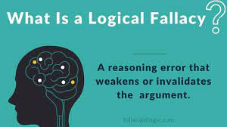
Introduction
Fallacious reasoning happens when:
People make mistakes in reaching a specific conclusion from a general premise;
Or irrationally draw a general conclusion from inadequate specific data;
Or mistakenly infer that one event has caused another.
THEY ARE THINKING FALLACIOUSLY.

Slide 3
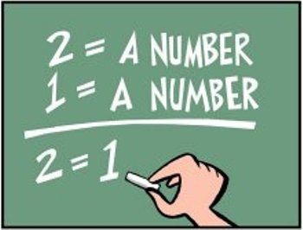
Introduction
A fallacy is an inference from data to a claim that circumvents sound, logical reasoning.
Logical fallacy = An error in reasoning that renders an argument invalid.
Fallacies are arguments that may sound logical, but are not.
There are dozens and dozens of types of logical fallacies. Let’s look at a few common fallacies….

Slide 4
1. Hasty Generalisations
Definition
Hasty generalisations are reasoned from too few examples or instances, to broad conclusions.
Tips
Careful examination can avoid many “-isms” – racism/sexism/classism etcetera.
Overgeneralisation from slim data often sweeps people/events from related categories under one blanket.
Watch out for words like, always and never.
Look for exceptions to generalisations, & qualify claims with probably, possibly, or perhaps.
Example: “You people are all alike”, represents this fallacy.

Slide 5
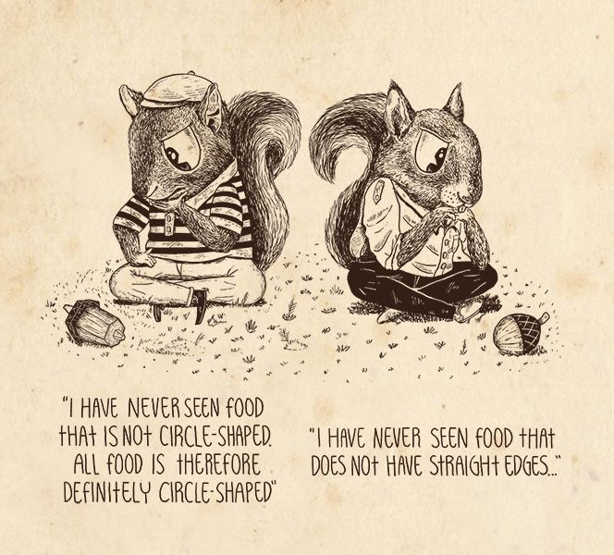
Hasty Generalisations

Slide 6
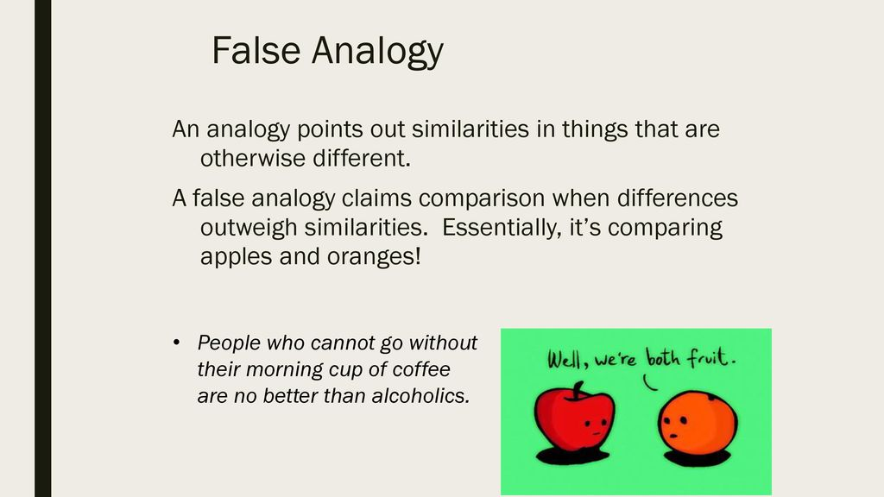
2. False Analogies
Definition
Comparisons of 1 thing to another because of similarities, when, in fact, they also have significant differences.
Tips
Identify differences.
If the 2 things don’t compare on all significant issues, reject the analogy.
They aren’t really alike in the relevant aspects. It is a comparison between two things that are different in some essential way.
Example: The battle against obesity is a war against children. Don’t fight your children, love them!

Slide 7
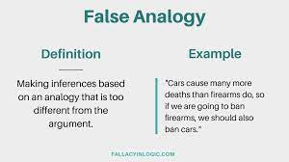
False Analogy

Slide 8
3. False Dilemmas
Definition
Tip
Anytime you hear a dichotomous statement, examine the alternatives to see what might lie between the extremes.
Artificial divisions of an issue into an either/or choice when both choices may be true or other alternatives may exist.
The arguer sets up the situation so it looks like there are only 2 choices. The arguer then eliminates 1 of the choices (the less desirable) so it seems we are only left with 1 option – the one he/she wants us to pick in the 1st place.
The false dilemma fallacy occurs when a limited number of outcomes, choices or views are presented as the only options, when in fact, more options exist.
Example: The E-learning centre has a whole in the roof. Either we tear the building down or risk students’ safety.

Slide 9
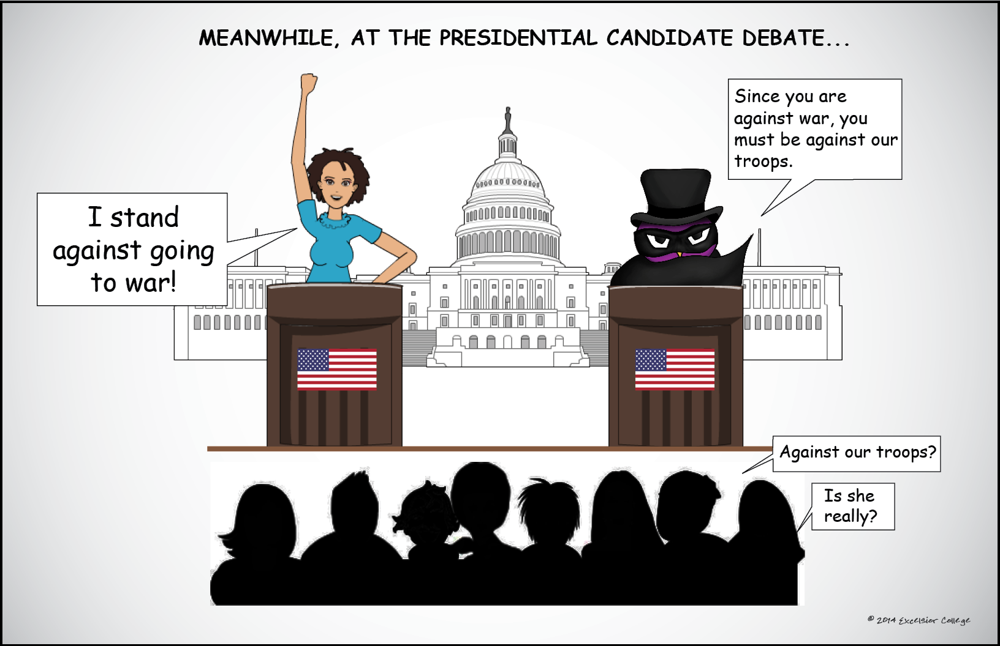
False Dilemma

Slide 10
4. Special Pleading
Definition
Giving special consideration to one entity over others because of bias, prejudice, or other preferential factors.
Tips
Not all situations are the same - you need to weigh suggestions for preferential treatment against established criteria and precedents.
It seeks to apply a different standard to similar situations. It involves the use of double standards.
Related fallacies include appeals to pity or to ignorance as special reasons for treating one situation differently from another.
Also base your decisions on the merits of the case and on your ethical evaluation.
Example - Context: Cape Town’s drought and hosepipe ban. “I know there is a drought and we need to save water, but I am putting my prize flowers in a competition next week, and I need to give them water”.
Example: “Sure, breaking the rules should be punished, but she is my daughter. I know she didn’t mean to do it”.

Slide 11
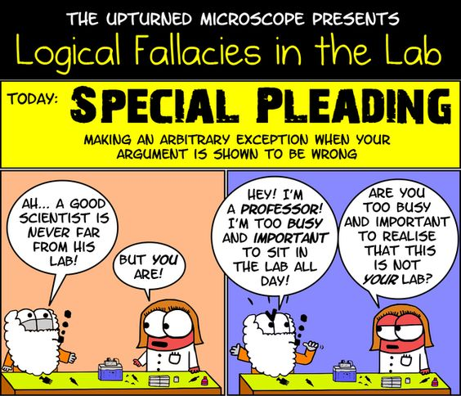
Special Pleading

Slide 12
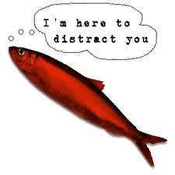
5. Red Herrings
Definition
Fallacies that divert attention from the real issue by presenting irrelevant arguments.
Tips
One way to examine this fallacy is to diagram the argument as Toulmin suggests.
The lack of relationship between the data, claim & warrant reveals a red herring.
Often the arguer never returns to the original issue.
Example: I know I bumped your car, but it wouldn’t have happened if you hadn’t made me so angry when you forgot to buy my birthday present.

Slide 13
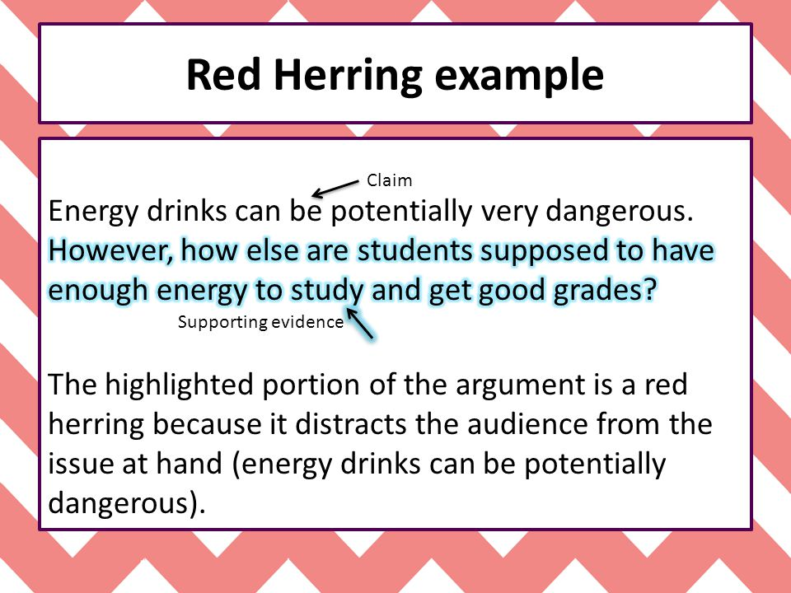
Red Herring
.

Slide 14

6. Circular reasoning
Definition
Tips
Using Toulmin’s diagram is a big help here.
If you see that the claim and the data, or that the data and the warrant are the same, you know you have circumlocution.
Reasoning that actually goes in a circle.
Example: I believe that Frosted Flakes is the tastiest cereal because it says so on the Frosted Flakes packaging.
.
.
.
.
.

Slide 15
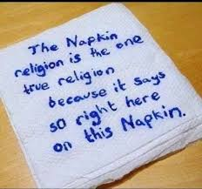
Circular reasoning

Slide 16

7. Straw Man
Definition
You misrepresented someone's argument to make it easier to attack.
Tips
By exaggerating, misrepresenting, or just completely fabricating someone's argument, it's much easier to present your own position as being reasonable, but this kind of dishonesty serves to undermine honest, rational debate.
Example: After Will said that we should put more money into health and education, Warren responded by saying that he was surprised that Will hates our country so much that he wants to leave it defenseless by cutting military spending.
While there are extreme examples, it’s important to be careful not to fall into this kind of fallacy on a smaller scale because it’s quite easy to do. Think about times you may have even accidentally misrepresented the other side in an argument. We have to be careful to avoid even the accidental straw man fallacy!
A straw man fallacy occurs when someone takes another person’s argument or point, distorts it or exaggerates it in some kind of extreme way, and then attacks the extreme distortion, as if that is really the claim the first person is making.
One who engages in this fallacy is said to be "attacking a straw man".

Slide 17
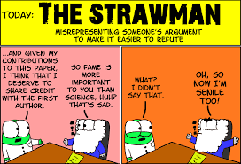
Straw Man

Slide 18
8. Ad Hominem
Definition
Or personal attack – avoids an issue by attacking the individual or the information source.
Tips
Try to focus on the issue, and disregard statements about individuals – unless those statements relate directly to the information’s credibility and to the issue at hand.
Example: That messy, unattractive slob couldn’t teach us anything we do not already know.

Slide 19
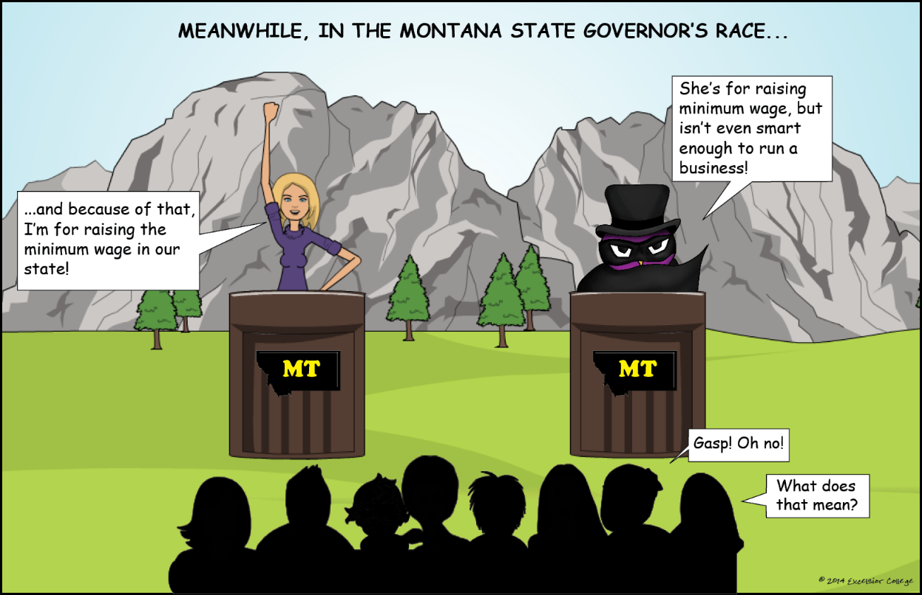
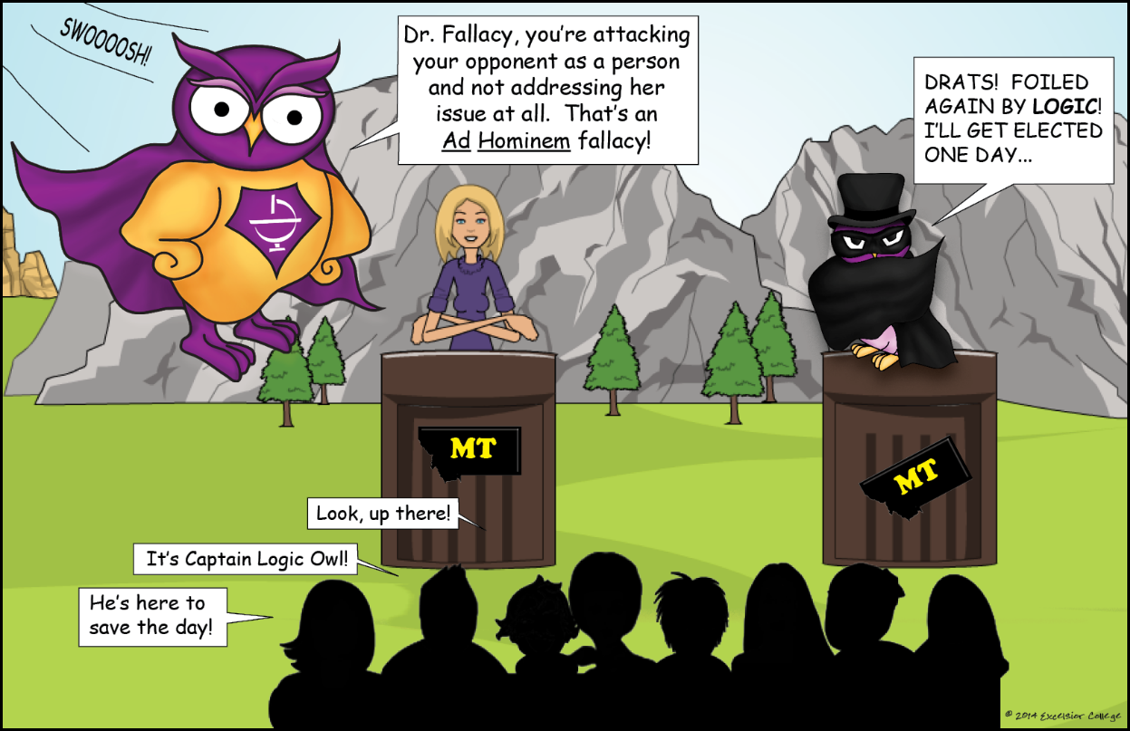
Ad Hominem

Slide 20
So how do I find fallacies in my own writing?
Pretend you disagree with the conclusion you're defending: What parts of the argument would now seem fishy to you? What parts would seem easiest to attack? Give special attention to strengthening those parts.
List your main points: Under each one, list the evidence you have for it. Seeing your claims and evidence laid out this way may make you realize that you have no good evidence for a particular claim, or it may help you look more critically at the evidence you're using.
Double check your characterizations of others, especially your opponents, to be sure they are accurate and fair.
Be aware that broad claims need more proof than narrow ones. Claims that use sweeping words like "all," "no," "none," "every,“, "always," "never," "no one," and "everyone" are sometimes appropriate—but they require a lot more proof than less- sweeping claims that use words like "some," "many," "few," "sometimes," "usually," and so forth.
Learn which types of fallacies you're especially prone to, and be careful to check for them in your work: Some writers make lots of appeals to authority; others are more likely to rely on weak analogies or set up straw men. Read over some of your old papers to see if there's a particular kind of fallacy you need to watch out for.

